Slide 1

Identify root components of website below

Slide 2

Root div
- Height: 100vh
content
nav
Flex: 0
header
Flex: 0
Flex: 1

Slide 3
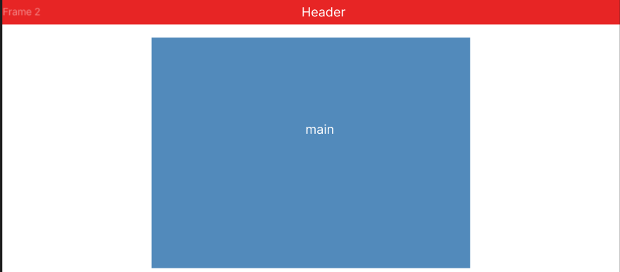

Slide 4
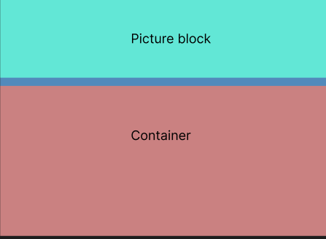
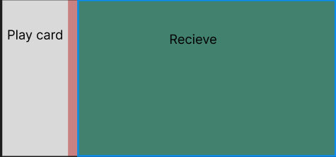

Slide 5
